Slide 1
11.10 K-Fold Cross-Validation

Slide 2
With ensembling human interpretability is typically lost as the final model is an average of many potentially very different nonlinearities.
K-fold cross-validation is often applied when interpretability of a final model is important.
Instead of averaging a set of cross-validated models over many splits of the data (ensembling), with K-fold cross-validation we choose a single model that has minimum *average validation error* over all splits of the data.
This produces a potentially less accurate final model, but one that is significantly simpler and hence more easily understood by humans.

Slide 3
The K-fold cross-validation procedure

Slide 4
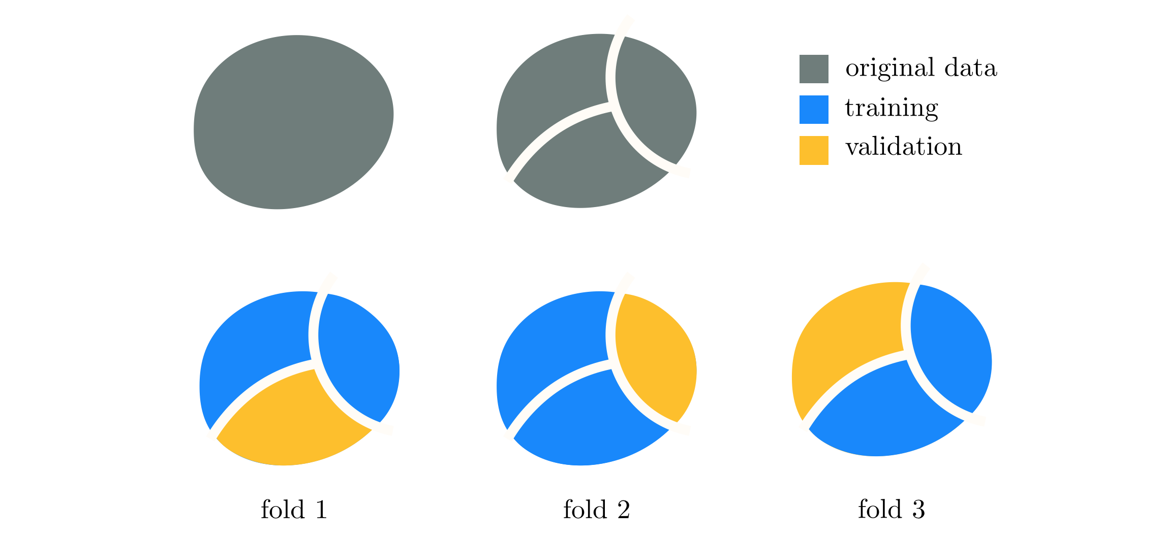
Schematic illustration of K-fold cross-validation for K=3. The original data (top left) is split into K non-overlapping sets or folds. In each instance we keep a different portion of the split data as validation while merging the remaining K-1 pieces as training.

Slide 5
Example: Galileo's gravity experiment

Slide 6
In this Example we use K-fold cross-validation on the Galileo dataset (see Example 10.2 in the book for details) using polynomial models of degree one through six.

Slide 7
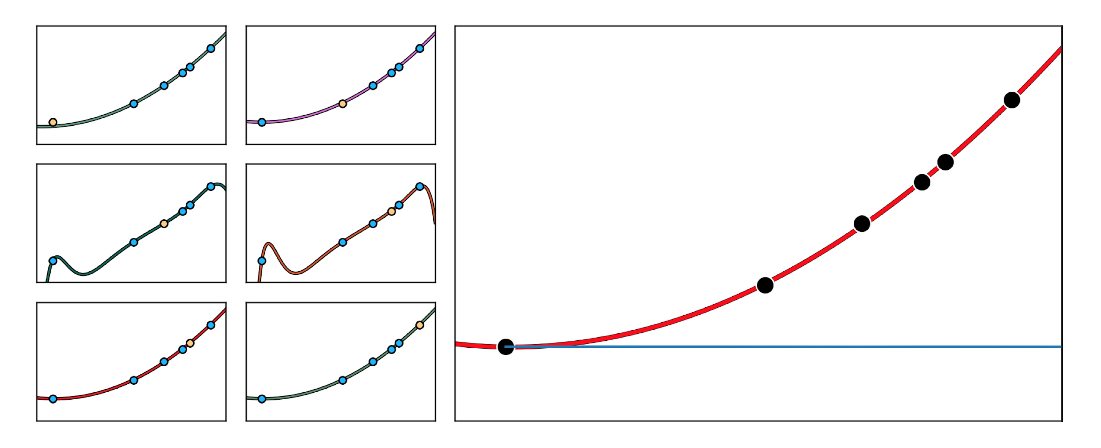
(small panels) Six cross-validated models, each trained on all but one point from the dataset (this sometimes referred to as leave-one-out cross-validation). Here the validation portion of each fold (i.e., a single data point) is highlighted in yellow. (large panel) The model with lowest average validation error is a quadratic.

Slide 8
K-fold cross-validation and high dimensional linear modeling

Slide 9
For small datasets that have very high input dimension, even a linear model has extremely high capacity and can easily overfit.
In such scenarios, the use of more complicated nonlinear models is automatically ruled out.
In order to properly tune the parameters of a high capacity (linear) model we often turn to regularization to block capacity.
Given the small amount of data at play, K-fold cross-validation is commonly employed to determine the proper regularization parameter value and ultimately the parameters of the linear model.

Slide 10
Example: Genome-wide association studies

Slide 11
Genome-wide association studies (GWAS) aim at understanding the connections between tens of thousands of genetic markers, taken from across the human genome of several subjects, with diseases like high blood pressure, diabetes, etc.
These studies typically produce small datasets of high dimensional (input) genetic information taken from a sample of patients with a given affliction and a control group of non-afflicted.
Thus regularization based cross-validation is a useful tool for learning meaningful (linear) models for such data.

Slide 12
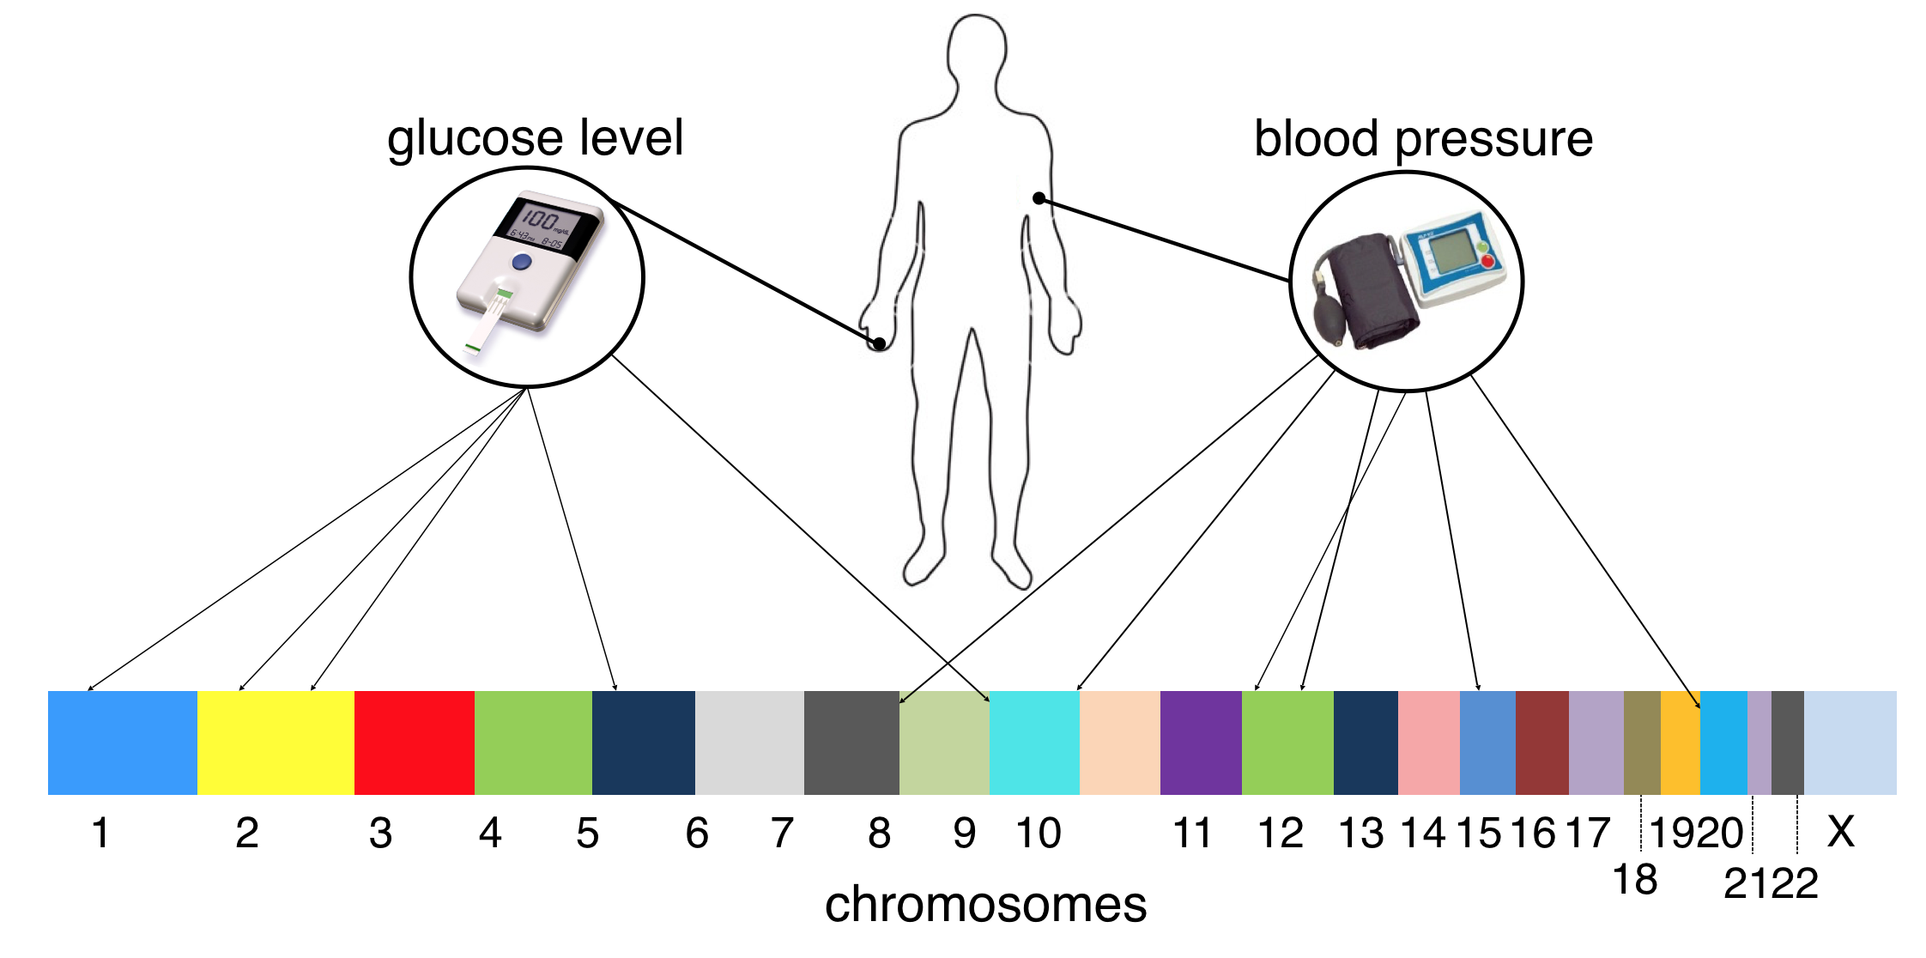
Conceptual illustration of a genome-wide association study wherein a quantitative biological trait (e.g., blood pressure or glucose level) is to be associated with specific genomic locations.

Slide 13
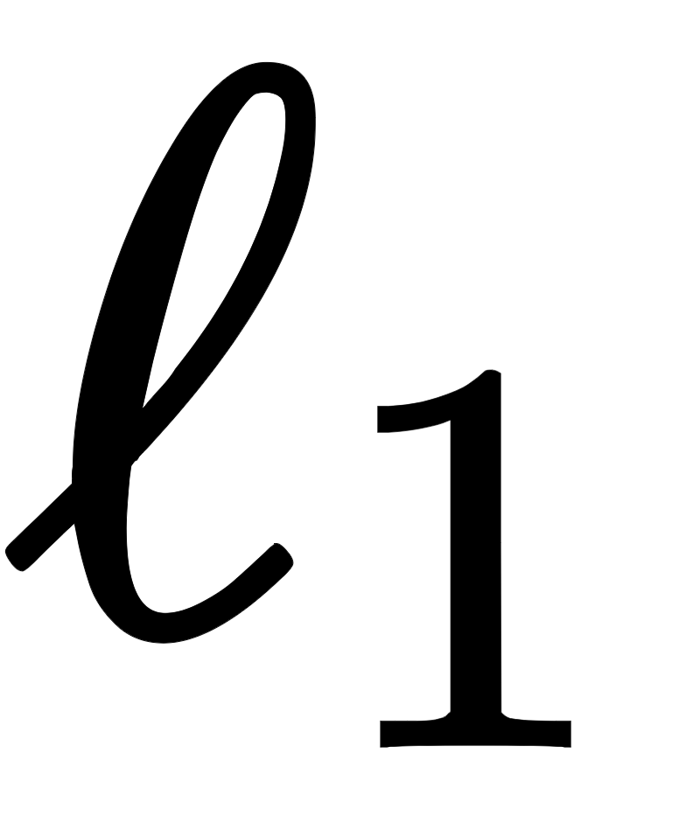
Using a feature selecting regularizer like the norm can help researchers identify the handful of genes critical to affliction, which can both improve our understanding of disease and perhaps provoke development of gene-targeted therapies.

